Slide 1
Metathon! 🐮 💻 🏃 Metathon == Meta-analysis + Marathon
Youngjun Na
Github: https://github.com/youngjunna
Email: ruminoreticulum@gmail.com

Slide 2
Goal
The goal of a metathon is to write the publishable meta-analysis paper by the end of the event (within 24 hours).
24 hour == 1 Meta-analysis paper

Slide 3
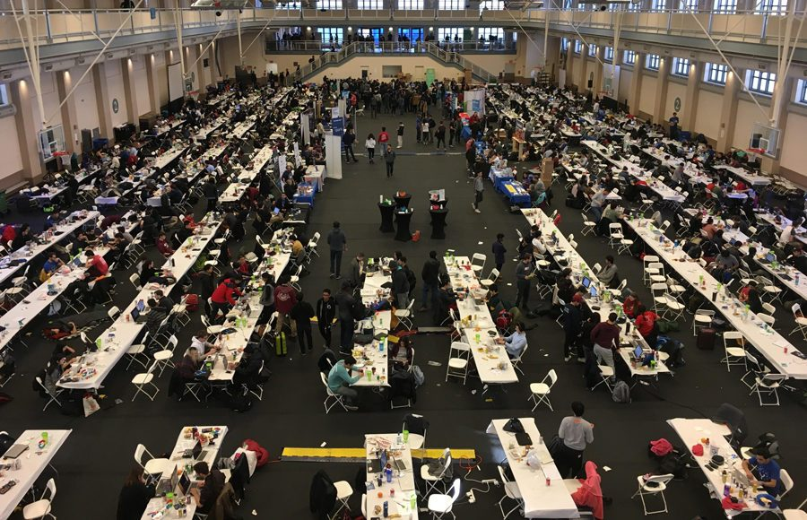
Hackathon?
People power sparks great ideas!

Slide 4
Members
Chief: Dr. Youngjun Na
Vice chief: Dr. Yongjun Choi
Members: ?
Sponsor: Sangrak Lee; Youngjun Na

Slide 5
Time and Location
Start: 09:00 6th June 2019
End: 09:00 7th June 2019
204 Animal Sci. Building Konkuk University

Slide 6
Target Journals
https://jcr.clarivate.com/
ASIAN-AUSTRALASIAN JOURNAL OF ANIMAL SCIENCES
LIVESTOCK SCIENCE
ANIMAL FEED SCIENCE AND TECHNOLOGY

Slide 7
Time table
● Data Work
● Paper Work
● ect.
09:00-09:30 ● Setting the PC, projector, snacks, and so on
09:30-10:30 ● Opening / ● Roadmap / ● structure of MA paper
10:30-13:00 ● Data scraping / ● Introduction; Acknowledgement
13:00-15:00 ● Break time
15:00-18:00 ● Data scraping / ● Material & methods
18:00-20:00 ● Data analysis
20:00-22:00 ● ● Discussion for following results / ● Results

Slide 8
Time table
● Data Work
● Paper Work
● ect.
22:00-02:00 ● Discussion
02:00-03:00 ● Literature Cited
03:00-04:00 ● ABSTRACT
04:00-05:00 ● Cover letter
06:00-07:00 ● Prepare the presentation / ● Final Check
07:00-08:00 ● Prepare the presentation / ● Submission OR translate service
08:00-09:00 ● Presentation / ● Closing

Slide 9
Team
1. Command post: YN🏅
2. Data team: ?? 🏅
3. Paper team: YC 🏅
4. Support team: ??🏅

Slide 10
Materials
Internet
PC / laptop
Printer
Snacks & Drinks
Nametags
Books

Slide 11
Paper Subject

Slide 12
Can you use ..
MS Word + Track changes https://support.office.com/ko-kr/article/word%EC%9D%98-%EB%B3%80%EA%B2%BD-%EB%82%B4%EC%9A%A9-%EC%B6%94%EC%A0%81-197ba630-0f5f-4a8e-9a77-3712475e806a
Google scholar
Google drive
Zotero
R

